Slide 1

Front End Engineering-II
Project Report Semester-IV (Batch-2022)
MOVIE APP
(using HTML CSS and JS)
Supervised By:
Raveesh Samkaria
Submitted By:
Pulkit Vashisht
2210992594
G-14
Department of Computer Science and Engineering Chitkara University Institute of Engineering & Technology,
Chitkara University, Punjab

Slide 2
1. INTRODUCTION
1.1 BACKGROUND
The Movie App project emerged from the increasing demand for digital platforms that facilitate easy access to movie-related information and entertainment content. With the proliferation of streaming services, digital movie libraries, and online databases, users seek centralized platforms where they can explore, discover, and engage with a vast array of movies conveniently. This project aims to address this need by leveraging modern web technologies and APIs to create an intuitive and feature-rich movie exploration platform.
Rationale for the Project:
In today's digital age, the consumption of movies and TV shows has shifted significantly towards online platforms.
Users often find it challenging to navigate through the abundance of movie options available across various streaming services and databases.
There is a growing demand for curated movie recommendations, detailed information about films, and user-friendly interfaces for browsing movie catalogs.
The Movie App seeks to streamline this process by providing a centralized hub where users can access comprehensive movie information, discover new titles, and engage with their favorite films effortlessly.
Utilization of Movie Database APIs:
The project relies on APIs provided by The Movie Database (TMDb), a popular online database for movies and TV shows.
TMDb offers extensive collections of movie data, including details such as titles, posters, ratings, synopses, release dates, and more.
By integrating TMDb APIs into the Movie App, developers can access a vast repository of movie information, ensuring that users have access to up-to-date and accurate data.
Target Audience:
The Movie App caters to a diverse audience of movie enthusiasts, ranging from casual viewers to avid cinephiles.
It is designed to appeal to users of all ages and demographics who have an interest in movies and enjoy exploring new titles.
The platform's user-friendly interface and intuitive features make it accessible to both tech-savvy individuals and those less familiar with digital technologies.
Focus on User Experience and Design:
A key focus of the project is to prioritize user experience (UX) and interface design to ensure that the platform is engaging, intuitive, and visually appealing.
Attention is given to aspects such as responsive design, intuitive navigation, clear presentation of information, and seamless interaction with movie content.
By incorporating best practices in UX/UI design, the Movie App aims to provide users with a satisfying and immersive browsing experience.
Through careful planning, thoughtful design, and integration of cutting-edge technologies, the project aims to provide a valuable resource for movie lovers worldwide.

Slide 3
1.2 OBJECTIVES
The primary objective of the Movie App project is to create a user-friendly and feature-rich platform for accessing movie-related information. Key goals include:
Data Retrieval: Fetching movie data from The Movie Database (TMDb) API, including popular movies and search results based on user queries.
Display: Presenting movie information in a visually appealing manner, with movie posters, titles, ratings, and other relevant details showcased prominently.
Interactivity: Enabling user interaction by allowing them to click on movies to view more detailed information in a modal window, including runtime and synopsis.
Search Functionality: Implementing a search feature that enables users to find specific movies by title, enhancing the user experience and facilitating content discovery.
Modal Window: Providing a modal window for displaying additional movie details, ensuring a focused and distraction-free viewing experience.
Responsive Design: Ensuring compatibility across various devices and screen sizes, guaranteeing accessibility and usability for all users.
By achieving these objectives, the Movie App aims to cater to movie enthusiasts, providing them with a comprehensive platform for exploring and discovering new films effortlessly.

Slide 4
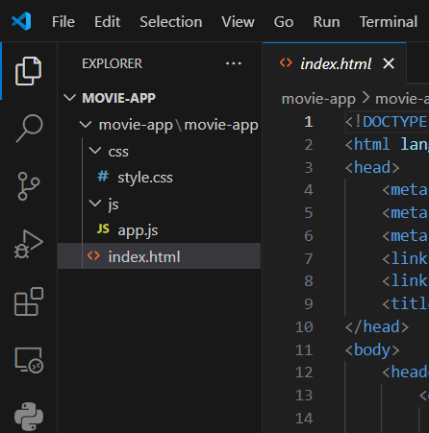
File Structure
PROBLEM DEFINITION AND REQUIREMENTS

Slide 5
Requirements
Movie Data Retrieval:
Integrate with The Movie Database (TMDb) API to fetch movie data, including titles, posters, ratings, synopses, release dates, and other relevant details.
Implement methods to retrieve popular movies and search results based on user queries.
User Interface (UI):
Design an intuitive and visually appealing user interface that enhances the browsing experience.
Ensure responsive design to accommodate various devices and screen sizes, including desktops, tablets, and smartphones.
Provide clear navigation menus, search bars, and filters to help users easily find and explore movie content.
Movie Display:
Display movie information in a structured and visually appealing manner, including movie posters, titles, ratings, release years, and average ratings.
Incorporate visual indicators such as color-coded ratings to highlight the quality of movies (e.g., green for high ratings, orange for moderate ratings, red for low ratings).
Search Functionality:
Implement a search feature that allows users to find specific movies by title, genre, actor, director, or other criteria.
Enable real-time search suggestions to assist users in refining their queries and discovering relevant movie titles.
Movie Details:
Provide detailed information about each movie, including runtime, genres, cast and crew, plot synopsis, and user reviews (if available).
Display movie trailers or video clips to give users a preview of the movie's content and style.
Modal Window for Detailed View:
Implement a modal window or popup to display additional details when users click on a movie.
Include options to close the modal window, allowing users to return to the main movie browsing interface seamlessly.
Performance Optimization:
Optimize the performance of the application by minimizing loading times, reducing network requests, and caching data where appropriate.
Implement lazy loading techniques to improve the loading speed of images and content, particularly for large movie collections.
Security:
Implement security best practices to protect user data and prevent unauthorized access.
Secure API requests by using HTTPS and handling sensitive information (e.g., API keys) securely on the server side.

Slide 6
REFERENCES
Since the Movie App project integrates with The Movie Database (TMDb) API, the primary reference used for API integration is the official documentation provided by TMDb.
Here's the reference for the TMDb API documentation:The Movie Database (TMDb) API Documentation:
Website: https://developers.themoviedb.org/3
Description: The official documentation for The Movie Database (TMDb) API provides comprehensive information on available endpoints, request parameters, authentication methods, response formats, and usage examples.
This documentation serves as a crucial reference for developers implementing API requests to fetch movie data for the Movie App project.
Additionally, any other specific libraries, frameworks, or resources used for handling API requests, parsing JSON responses, or other related tasks within the project may also be referenced. However, since the provided code snippet primarily interacts with the TMDb API directly using native JavaScript and the fetch API, the TMDb API documentation is the primary reference for API integration in this context.

Slide 7
Methodologies - Code snippets
HTML code
<!DOCTYPE html>
<html lang="en">
<head>
<meta charset="UTF-8">
<meta http-equiv="X-UA-Compatible" content="IE=edge">
<meta name="viewport" content="width=device-width, initial-scale=1.0">
<link rel="stylesheet" href="css/style.css">
<link rel="shortcut icon" href="favicon/movie.png" type="image/x-icon">
<title>Movie App</title>
</head>
<body>
<header class="header container">
<div class="header__content">
<a href="index.html" class="header__logo">Movie<span>App</span></a>
<form action="">
<input type="text" class="header__search" placeholder="Search">
<button class="header__btn">search</button>
</form>
</div>
<div class="container">
<div class="movies">
</div>
<div class="modal">
</div>
</div>
</header>
<script src="js/app.js"></script>
</body>
</html>

Slide 8
(2) JS code
const TMDB_API_KEY = 'd693aea0faebf856f7cfc6a27f185da8';
const TMDB_API_URL_POPULAR = 'https://api.themoviedb.org/3/movie/popular';
const TMDB_API_URL_SEARCH = 'https://api.themoviedb.org/3/search/movie';
const TMDB_API_URL_MOVIE_DETAILS = 'https://api.themoviedb.org/3/movie/';
getMovies(TMDB_API_URL_POPULAR);
async function getMovies(url) {
const response = await fetch(url + `?api_key=${TMDB_API_KEY}`);
const responseData = await response.json();
showMovies(responseData.results);
}
function getClassByRate(vote){
if(vote >= 7){
return 'green';
} else if (vote > 5) {
return 'orange';
} else {
return 'red';
}
}
function showMovies(data) {
const movies = document.querySelector('.movies');
movies.innerHTML = '';
data.forEach((movie) => {
const movieEl = document.createElement('div');
movieEl.classList.add('movie');
movieEl.innerHTML = `
<div class="movie__cover-inner">
<img src="https://image.tmdb.org/t/p/w500/${movie.poster_path}" alt="${movie.title}" class="movie__cover">
<div class="movie__cover--darkened"></div>
</div>
<div class="movie__info">
<div class="movie__title">${movie.title}</div>
<div class="movie__average movie__average--${getClassByRate(movie.vote_average)}">${movie.vote_average}</div>
</div>
`;
movieEl.addEventListener('click', () => openModal(movie.id));
movies.appendChild(movieEl);
});
}
const form = document.querySelector('form');
const search = document.querySelector('.header__search');
const btn = document.querySelector('.header__btn');

Slide 9
btn.addEventListener('click', (e) => {
e.preventDefault();
const apiSearchUrl = `${TMDB_API_URL_SEARCH}?api_key=${TMDB_API_KEY}&query=${search.value}`;
if(search.value) {
getMovies(apiSearchUrl);
search.value = '';
}
});
// Modal
let modalEl = document.querySelector('.modal');
async function openModal(id) {
const response = await fetch(TMDB_API_URL_MOVIE_DETAILS + `${id}?api_key=${TMDB_API_KEY}`);
const responseData = await response.json();
modalEl.classList.add('modal--show');
document.body.classList.add('stop-scrolling');
modalEl.innerHTML = `
<div class="modal__card">
<img src="https://image.tmdb.org/t/p/w500/${responseData.poster_path}" alt="" class="modal__movie-backdrop">
<h2>
<span class="modal__movie-title">Title: ${responseData.title}</span>
<span class="modal__movie-release-year">Release Year: ${responseData.release_date.substring(0, 4)}</span>
</h2>
<ul class="modal__movie-info">
<li class="modal__movie-runtime">Runtime: ${responseData.runtime} minutes</li>
<li class="modal__movie-overview">Overview: ${responseData.overview}</li>
</ul>
<button type="button" class="modal__button-close">Close</button>
</div>
`;
const btnClose = document.querySelector('.modal__button-close');
btnClose.addEventListener('click', () => closeModal());
}

Slide 10
function closeModal() {
modalEl.classList.remove('modal--show');
document.body.classList.remove('stop-scrolling');
}
window.addEventListener('click', (e) => {
if(e.target === modalEl) {
closeModal();
}
});
window.addEventListener('keydown', (e) => {
if(e.keyCode === 27){
closeModal();
}
});

Slide 11
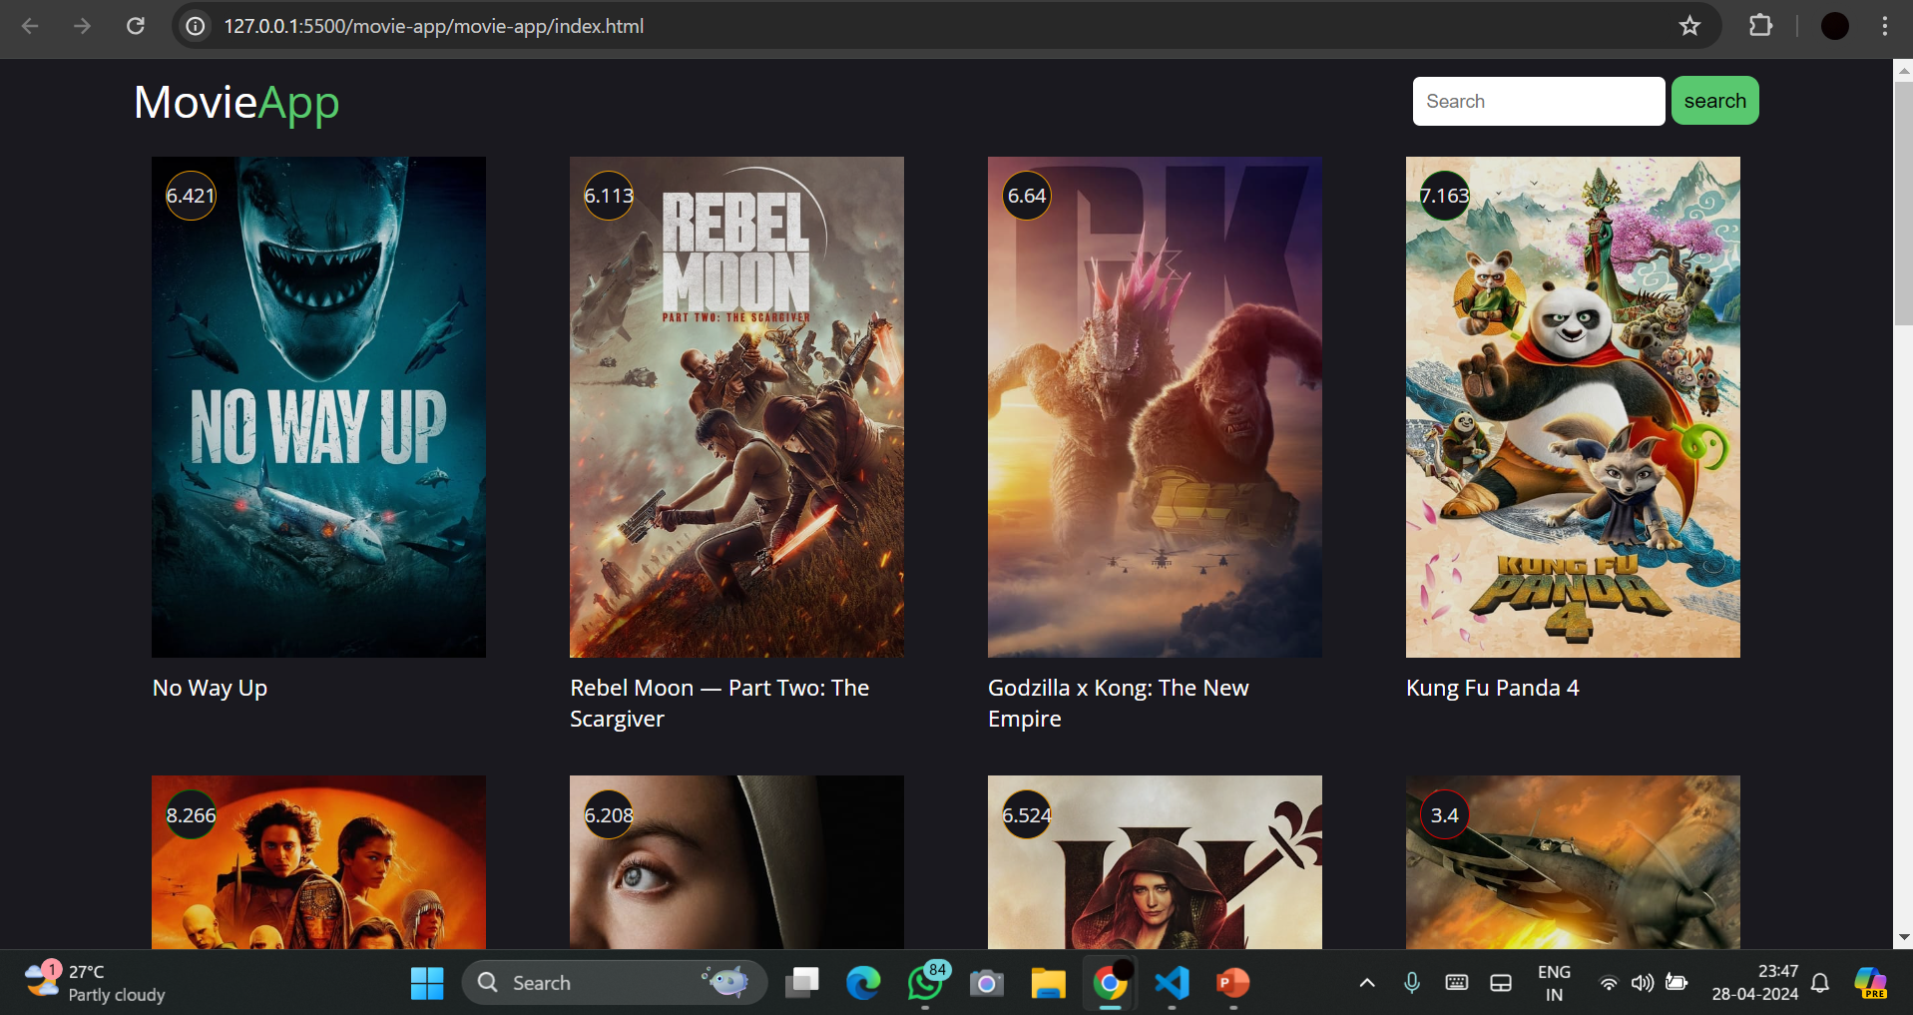
Result
Snippets of the resultant webpage are attached below:-
(1) DESKTOP VIEW

